Slide 1
Vivado Tutorial 2 – Synthesis, Implementation and Running on Board
ISDN 4400

Slide 2
Preface
This is a serial of tutorials telling you how to use Xilinx Vivado Design Tools to do/verifying VLSI design with FPGA. You could also look for official tutorials in Xilinx design hub or seeking help from YouTube.
This tutorial follows Xilinx UltraFast Design Methodology. If you are interesting in doing industrial level FPGA project, you could do an in-depth learning on this methodology.
Tutorial 1 tells you how to setup an Vivado project and do circuit behaviour simulation.
Tutorial 2 tells you how to setting up the timing and I/O port constraints for synthesis, implementation and finally generate the Bitstream to running on the developing board.

Slide 3
Bookmarks
Synthesis and Timing Constraint
Implementation and Port Constraint
Running on Board

Slide 4
I. Synthesis and Timing Constraint

Slide 5
I. Synthesis and Timing Constraint
After simulation, you have already verified that your design logic is correct. But can this design run fast enough to meet your target clock rate (e.g. 100MHZ)? And how much power and chip area will this design consume? You need the synthesis to give you the rough estimation.
Timing Constraint is a XDC file (TCL language) used to tell Vivado how fast you clock is (clock profile). You also need to include the minimum and maximum input delay for Vivado to estimate the setup and hold time.
Minimum input (port) delay is for hold time estimation. Because after the raising edge of clk, the signal still need to hold for some time to avoid hold time violation. You can give a random small but large enough number to it (like 0.3 ns). Because during implementation, Vivado will automatically add buffer to make your path meet the hold time requirement. It’s only to make sure that your Verilog coding style won’t be that unlucky to induce the hold time violation.
Maximum input (port) delay is for setup time estimation thus it’s more meaningful. It includes everything from the output register of the former circuit block to the input register of the current block, which normally consists of input routing (wire) delay, clock to q delay and PCB delay (if any). In practice we give a random value higher than minimum input delay, and leave some setup time margin (like 5% of the clock time) during implementation.
An very important thing is design with timing violation reported from synthesis or implementation may still works on chip, but after running correctly for a while the chip may gives you some unexpected error. Thus a good constraint file makes your customers complain less.

Slide 6
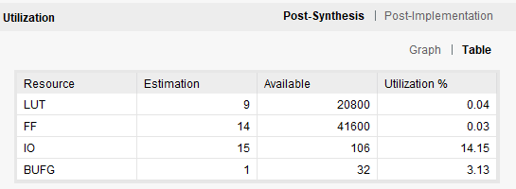
I. Synthesis and Timing Constraint
To add a timing constraint file, click on “Add sources” -> “Add or create constraints”.
Copy the clk.xdc from my Github (charlesjiangxm->ISDN4400) at this time.
Then click run synthesis
After that you can see the resource utilization from the project summary under the synthesis view.

Slide 7
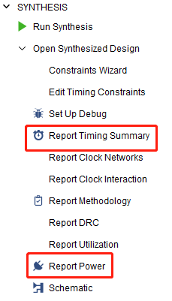
I. Synthesis and Timing Constraint
For timing and power estimation you need to click on the bottom, leave all settings as default and see the report.

Slide 8
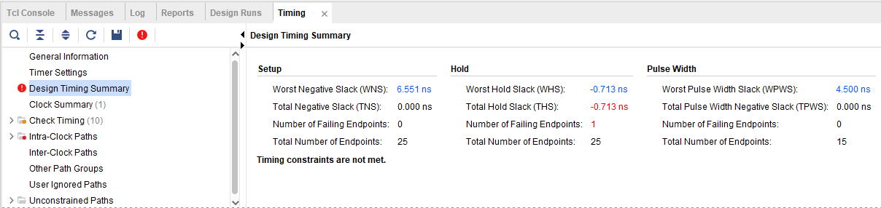
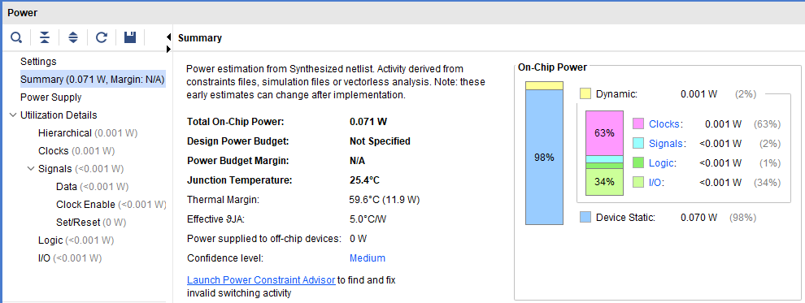
I. Synthesis and Timing Constraint
Red words means you have timing constraint, for example here you have hold time violation, try increase the minimum input delay to solve it.
Power report is shown like this.

Slide 9
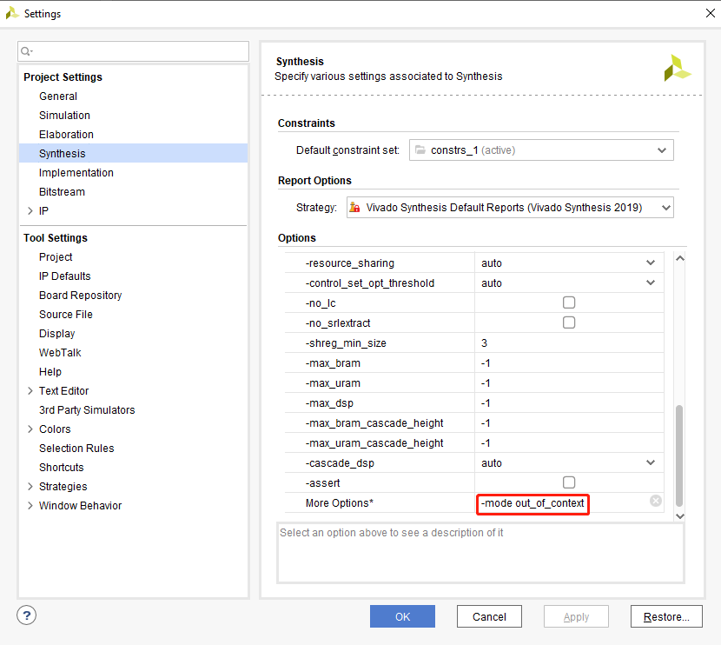
I. Synthesis and Timing Constraint
Note if you are implementing an internal block, which means you don’t need Vivado to map your input/output to real I/O ports. It’s very important to add “-mode out_of_context” to Synthesis settings.
Else Vivado will add I/O delay to your design, which is extremely slow (we normally use one clock cycle just for I/O).
Don’t do that for this design

Slide 10
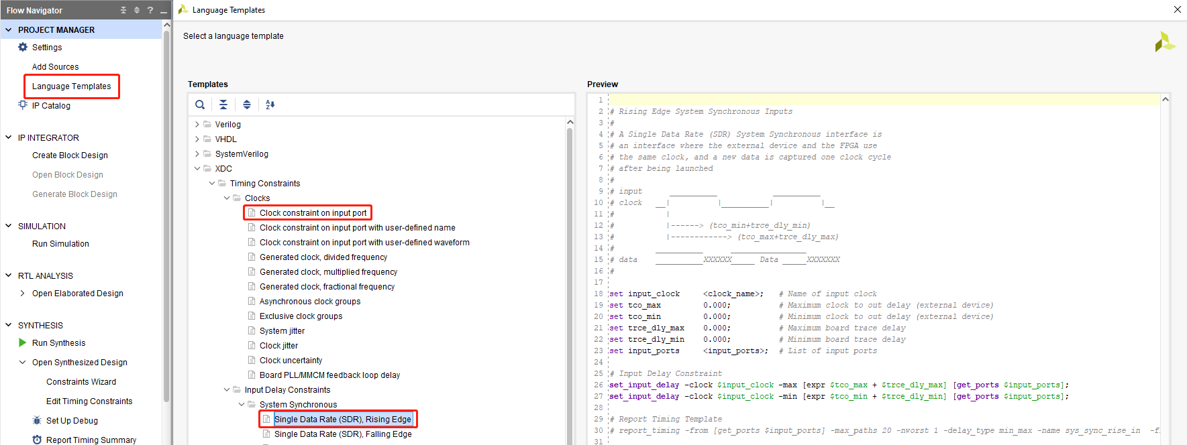
I. Synthesis and Timing Constraint
Note that Vivado also has some Language Templates that you can refer to for writing the timing constraints.

Slide 11
II. Implementation and Port Constraint

Slide 12
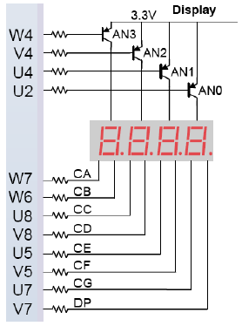
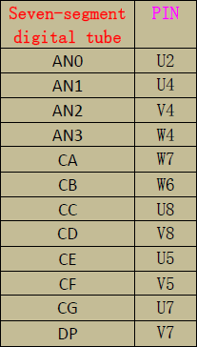
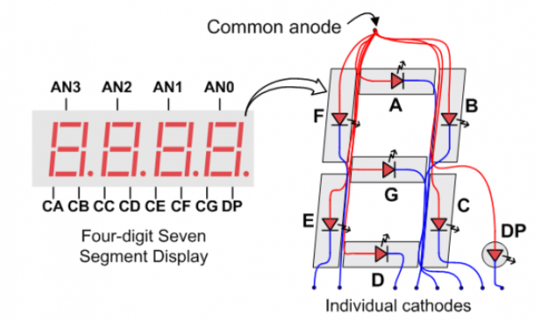
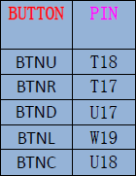
II. Implementation and Port Constraint
Synthesis is a very rough estimation on your design. Implementation takes the real I/O port (Pin location and electric property) and actual FPGA resource mapping into consideration. Thus you need to give it a port constraint.
Please download the “port.xdc” from my Github (charlesjiangxm->ISDN4400).
Then click implementation to run.
Note that your developing board manual (or PCB schematic) will tells you the actually pin location and e-property. Normally your vendors or PCB engineers will give you example constraint files. For example, you can found the ports related to 7 segment display and bottom as follows.

Slide 13
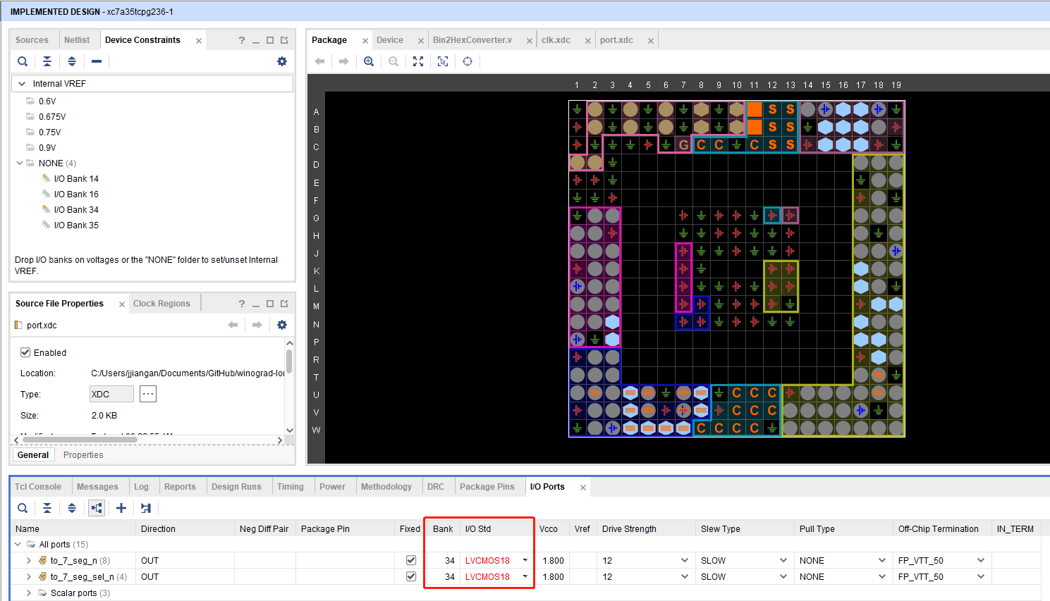
II. Implementation and Port Constraint
Note that you could also manually mapping the pins. To do that run implementation without port.xdc file, the implementation will be success because Vivado will automatically guess a mapping for you. But it won’t let you proceed to generate the bitstream if you don’t manually check the mappings.
Change the part in the red square

Slide 14
III. Running on Board

Slide 15
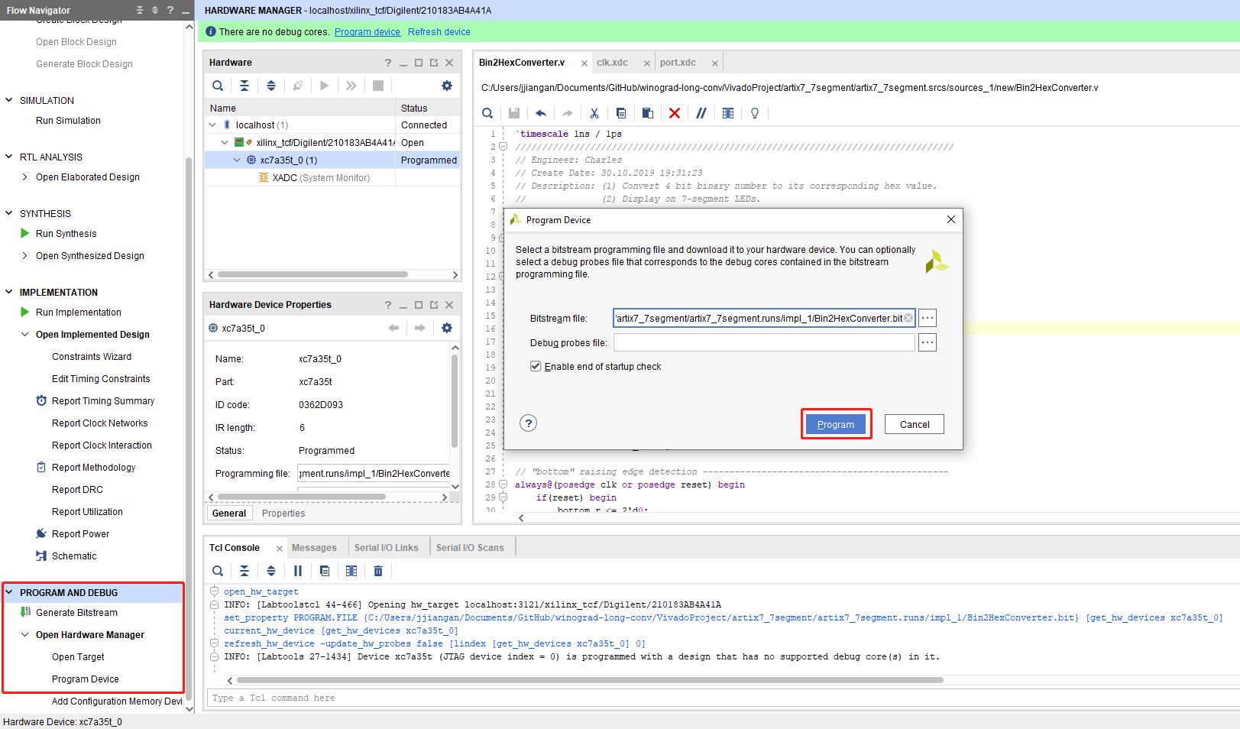
III. Running on Board
Now we are ready to run our design on board and enjoy.
Click “Generate the Bitstream”.
Click “Open Hardware Manager” ->”Open Target” -> “Auto Connect” -> “Program Device”.

Slide 16
Thank you
This is the end of this tutorial

